Slide 1
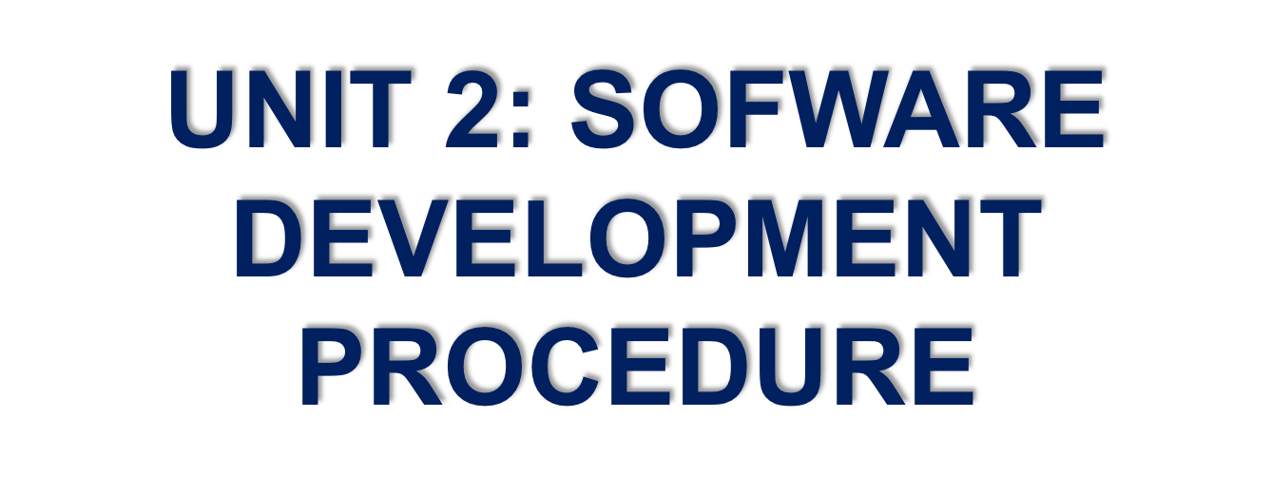


Slide 2
OVERALL OBJECTIVES
At the end of this unit, students will be able to:
- identify steps in software development procedure
- describe steps in software development procedure

Slide 3
LESSON 1
Overall objectives:
At the end of this lesson, students will be able to:
- identify basic concepts, descriptions and sequences of stages of some common software development procedure.

Slide 4
ACTIVITY 1: WHO IS FASTER?
Objectives:
Upon completion of this activity, students will be able to remember the target words or phrases referring to software development procedure.

Slide 5
INSTRUCTIONS:
Stand up
Listen teacher saying the words in English or Vietnamese
Say BINGO to give the equivalent words in Vietnamese or English
If your answer is correct, sit down and choose 2 other friends in your team to sit down
If you can’t give the correct answer, choose 2 other students to stand up.
The team with more students to sit down will be the winner.

Slide 6
ACTIVITY 2: MATCHING AND MAKING SENTENCES
Objectives:
Upon completion of this activity, students will be able to identify and make sentences to describe stages of software development procedure.

Slide 7
INSTRUCTIONS:
- Work in pairs
- Look at the names of stages of software development in the right column and match them with their explanations or descriptions in the left column
- Make full sentences to talk about the stages of software development procedure
- Get one point for a correct answer
- The group with higher point will be the winner.

Slide 8
Application software | Descriptions/ Explanations
1. Planning | a. Once/ software/ develop,/ stage/ implementation/ come in/ where/ product/ go/ through/ pilot study.
2. Analysis | b. Planning/ kick off/ project/ flawlessly/ affect/ progress/ positively
3. Design | c. Step/ about/ analyze/ performance/ software/ various/ stages/ making/ note/ additional/ requirements
4. Development & Implementation | d. Testing/ stage/ which/ assess/ software/ errors/ documents bugs/ if/ there/ any.
5. Testing | e. Once/ software/ pass/ through/ all stages/ without/ any/ issue,/ it/ undergo/ maintenance process.
6. Maintenance | f. Once/ analysis/ complete,/ step/ designing/ take over.
a. Once the software is developed, the stage of implementation comes in where the product goes through a pilot study.
b. Planning kicks off a project flawlessly and affects its progress positively.
c. This step is about analyzing the performance of the software at various stages and making notes on additional requirements.
d. Testing is the stage which assesses the software for errors and documents bugs if there are any.
e. Once the software passes through all the stages without any issues, it is to undergo a maintenance process.
f. Once the analysis is complete, the step of designing takes over.

Slide 9
ACTIVITY 3: ODERING
Objectives:
Upon completion of this activity, students will be able to order and talk about the steps of software development procedures.

Slide 10
INSTRUCTIONS:
- Work in 2 groups
- Reorder the steps of software development procedures
- Use adverbs of sequence to make a short talk describing the procedures

Slide 11

Steps | Answer
a. Do some market research
b. Sketch your app idea
c. Improve your app with user feedback
d. Make your app’s graphic design
e. Market your app to reach the right people
f. Build your app landing page
g. Make the app with Xcode and Swift
h. Launch the app in the App Store
i. Create mockups of your app
1. b. Sketch your app idea
2. a. Do some market research
3. i. Create mockups of your app
4. d. Make your app’s graphic design
5. f. Build your app landing page
6. g. Make the app with Xcode and Swift
7. h. Launch the app in the App Store
8. e. Market your app to reach the right people
9. c. Improve your app with user feedback

Slide 12
Keys: b-a-i-d-f-g-h-e-c
Sketch your app idea
Do some market research
Create mockups of your app
Make your app’s graphic design
Build your app landing page
Make the app with Xcode and Swift
Launch the app in the App Store
Market your app to reach the right people
Improve your app with user feedback

Slide 13
Sample:
First, sketch out your app idea with pen and paper. The goal is to make the idea tangible. Next, do market research before you make your app because it can save you from making a lot of mistakes early on. Then, it’s best to make mockups before you start to build the app. A mockup is a rough sketch of your app’s layout, user interfaces and flow. After that, it’s time to make a graphic design for your app. Your app’s design includes pixel-perfect visual details, graphic effects, image assets, and sometimes even animations and motion design. In the next step, you should at least create a landing page for your app, and ideally before you build your app.

Slide 14
Remember Xcode and Swift are considered must-have tools to make an iOS app. Now that you’ve built the app, it is time to launch it in the App Store. Then, market your app to reach the right people because marketing is the voice that tells people who you are, what you stand for, and how you’re different from available alternatives. Finally, real user feedback is important for making an app. You had better use a user’s experience, and their feedback to improve your app.

Slide 15
LESSON 2

Slide 16
ACTIVITY 4: MAGIC BOX
Objectives:
Upon completion of this activity, students will be able to make sentences about application software using grammatical structures they have learnt online

Slide 17
INSTRUCTIONS:
Work individually
Pass the box while listening to music
- When the music stops, the student who holding the box has to pick up a card and makes a sentence with a clue given within 5 seconds
Keep the card if you give the correct answer
The one getting the most cards at the end will be the winner

Slide 18
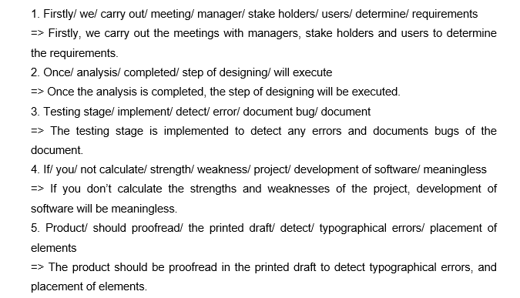
Suggested answer:

Slide 19
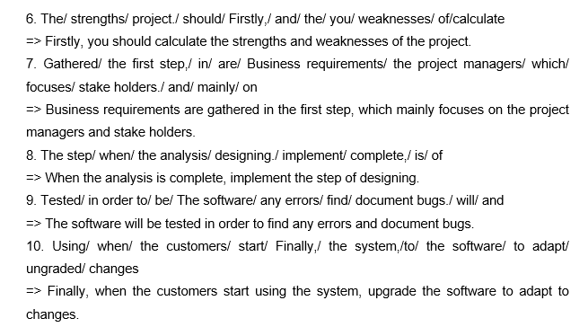
Suggested answer:

Slide 20
ACTIVITY 5: HOW MUCH DO YOU KNOW
Objectives:
Upon completion of this activity students will be able to describe procedures to develop specific software.

Slide 21
INSTRUCTIONS:
- Work in 4 groups
- Order steps to develop some specific software
- Report the results in front of the whole class

Slide 22
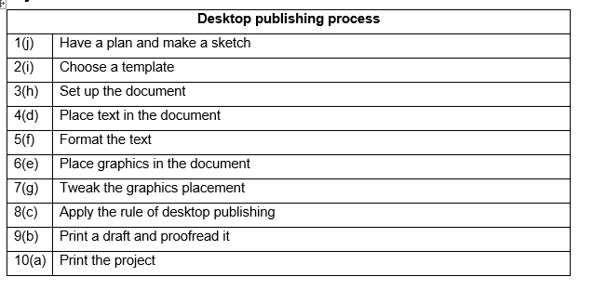
Suggested answer:

Slide 23
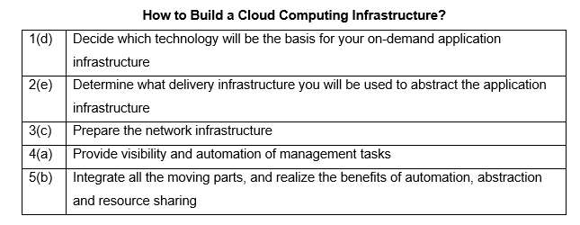
Suggested answer:

Slide 24
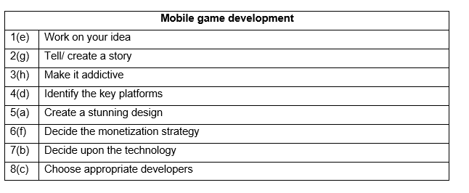

Suggested answer:

Slide 25
ACTIVITY 6: EXCHANGING INFORMATION
Objectives:
Upon completion of this activity, students will be able to make a conversation to ask and answer questions about software development procedure

Slide 26
INSTRUCTIONS:
- Work in pairs
- Look at the cards, make a conversation based on the information given

Slide 27
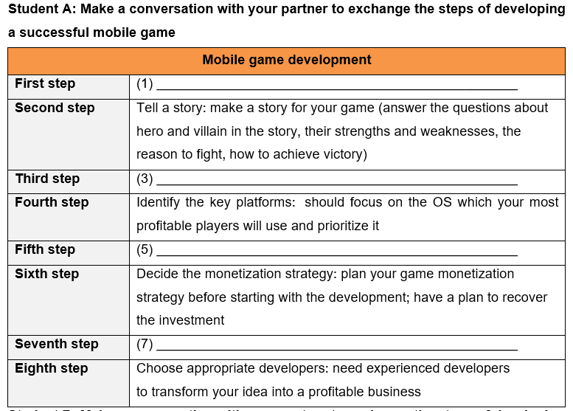
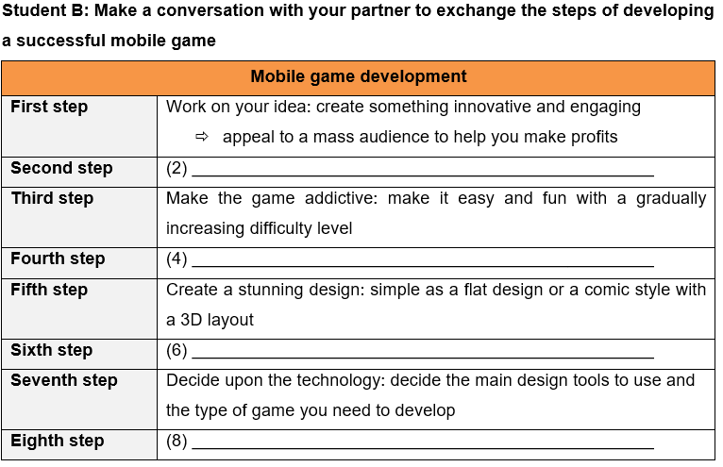

Slide 28
B: Hi. How are you today?
A: I’m fine. Thank you, and you?
B: Me too. Do you know how to develop a mobile game?
A: Yes, but I haven’t known the whole process to develop it. Can we exchange the mobile game development procedure to each other?
B: Absolutely yes./ Sure.
A: Well, I’ll ask you first.
……

Slide 29
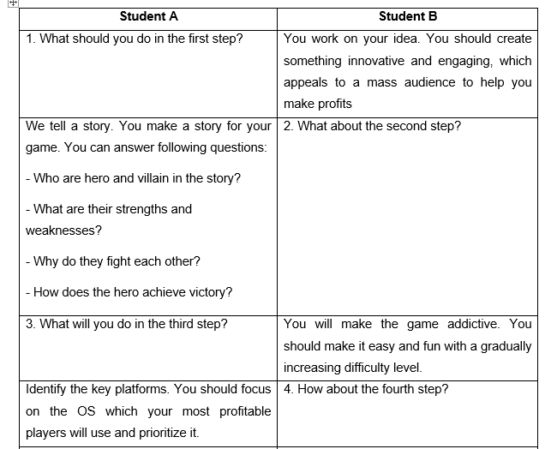

Slide 30
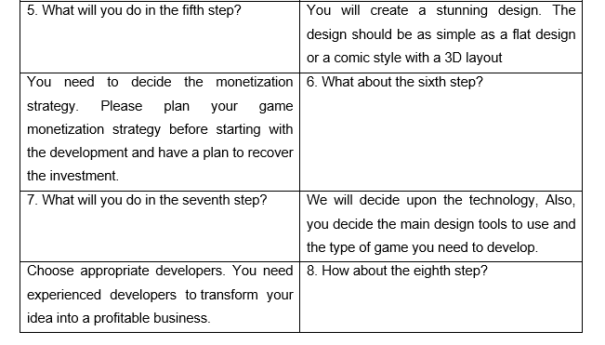

Slide 31
B: Well. Thank you very much for your useful information. Now I can understand more about the process to develop a mobile game.
A: You’re welcome.

Slide 32
FREE TALK
Describe the steps to develop a piece of software you know well
Suggested questions:
1. What software do you want to describe?
2. What is this software used for?
3. How many steps are there?
4. What are the steps?
5. What notes do you need to consider? (if necessary)

Slide 33
OUTLINE
Name of software: Google chrome is a cross-platform web browser developed by Google.
Functions: access web pages on the Internet
Steps: 6 main steps including planning, analysis, design, development, testing, maintenance
Steps:
Planning: In the planning step, the developer gathered information from clients and built an overview of the software

Slide 34
Analysis: the software was analyzed carefully to ensure that it would function properly at the end.
Design: Design was a super-important part of developing the software which basically built the architecture of the software such as layout, interface, navigation,…
Development: The development phase was about writing code and converting design documentation into the actual software within the software development process.

Slide 35
Testing: The testing stage assessed the software for errors and bugs if there were any.
Maintenance: Once the software passed through all the stages without any issues, a maintenance process was followed wherein it would be maintained and upgraded from time to time to adapt to changes.

Slide 36
5. Notes: Google Chrome is the browser with billions of users. What should we do to make our software more accessible to users like Chrome does? Therefore, when developing software, developers should consider the usefulness and impression that the software brings to users, how to make it useful, outstanding and different from an ocean of software nowadays.

Slide 37


